Slide 1
Fluctuations in stock prices based on tweets using sentiment analysis
Project Group 12

Slide 2
Introduction
21st Century is a digital book. Today, a powerful microblogging such as Twitter is a sharp sword. Tweets don’t just influence policies, they move markets.
In this project, we employ the data from Twitter to analyze how a tech giant, a global icon can influence the emotions of the millions connected, and in turn how these emotions play a role in the rise and fall of stocks of an organization.
Throughout the project, we’ll see how stock prices of Tesla were affected by Elon Musk’s tweets.

Slide 3
What Is Sentiment Analysis And Why Do We Need It ?
The task of sentiment analysis typically involves taking a piece of text, whether a comment, a sentence or a tweet and returning a “score” that measures how positive or negative the text is.
In today’s environment where we’re suffering from data overload, Sentiment analysis provides some answers into what the most important issues are, from the perspective of people, at least. Because sentiment analysis can be automated, decisions can be made based on a significant amount of data rather than plain intuition that isn’t always right.

Slide 4
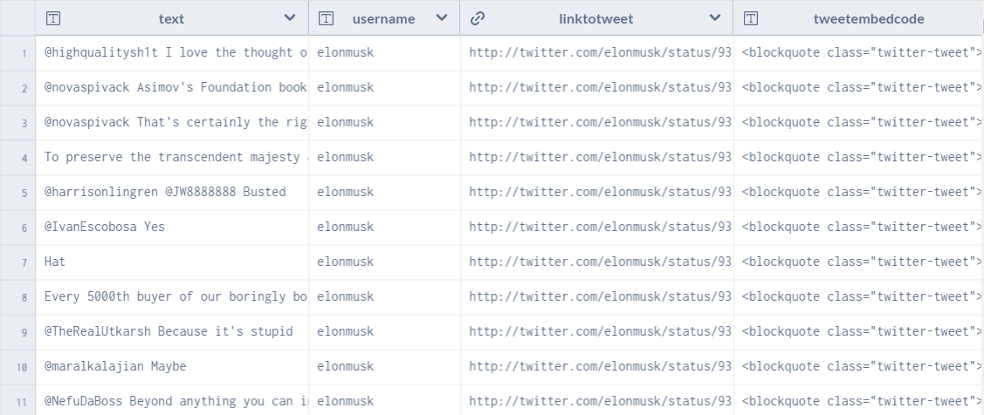
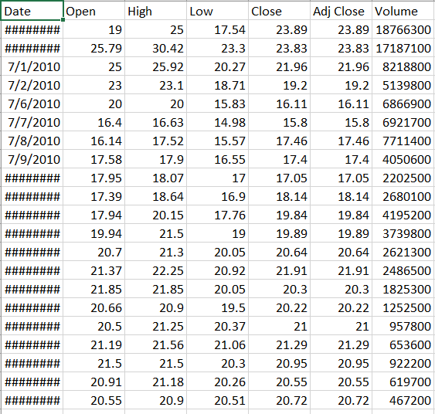
Datasets Used
Here, we’re using two datasets.
Elon Musk’s tweets in the past two years i.e. 2018-2020 https://data.world/barbaramaseda/elon-musk-tweets/workspace/file?filename=user-tweets.jsonl
Tesla Stock data https://www.kaggle.com/timoboz/tesla-stock-data-from-2010-to-2020

Slide 5
Packages Used
Package Name | Purpose
Sqlite3 | For sqlite database operations
Pandas | For data manipulation and processing
Json | For reading tweets from the dataset
Natural Language Toolkit(nltk) | For data preprocessing and cleaning
Valence Aware Dictionary And Sentiment Reasoner (VADER) | For tweet sentiment analysis scores
Matplotlib | For data plotting
plotly | Interactive graphs

Slide 6
Code Flow
Let’s go through the code flow for the following:
Data Parsing
Loading into the Database
Data Preprocessing
Sentiment Analysis
Correlation of Tweet Sentiment Scores to Tesla Stock Prices using plots

Slide 7
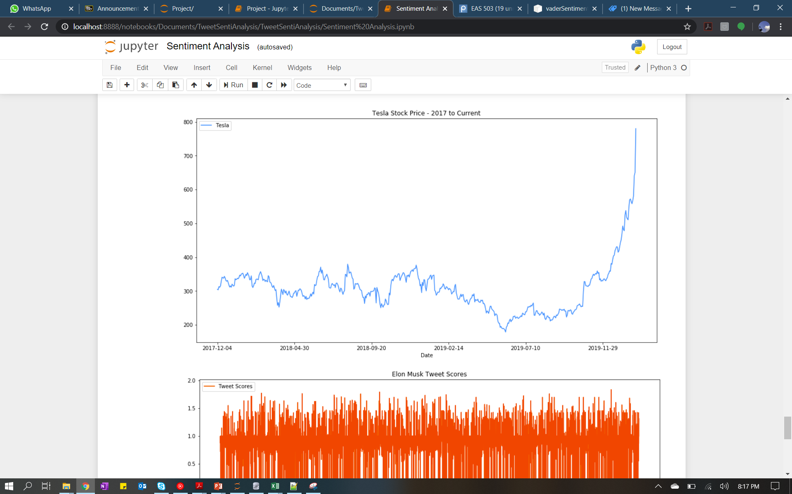
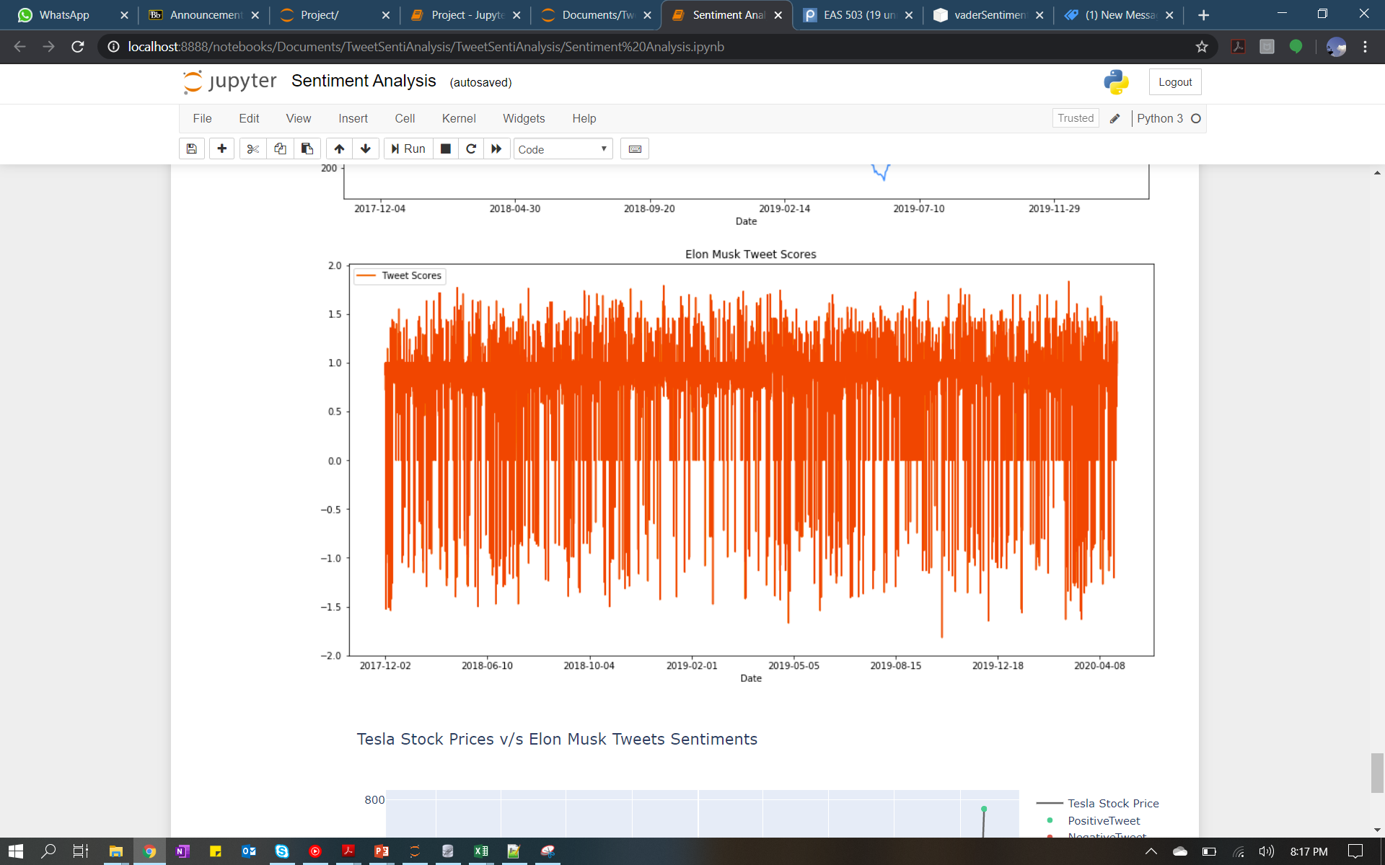
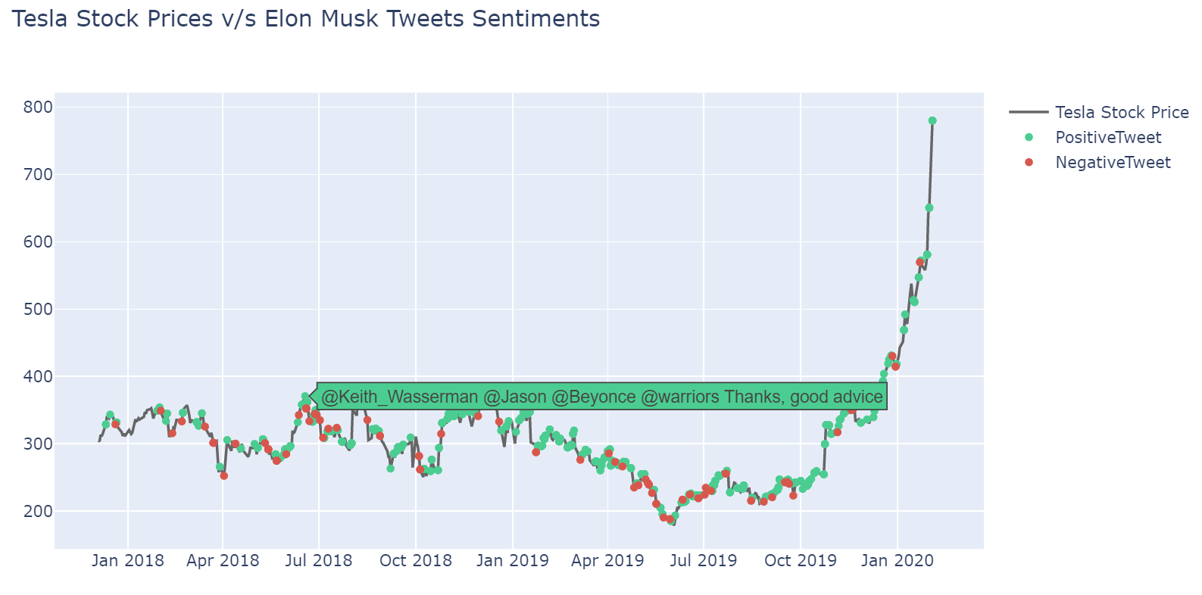
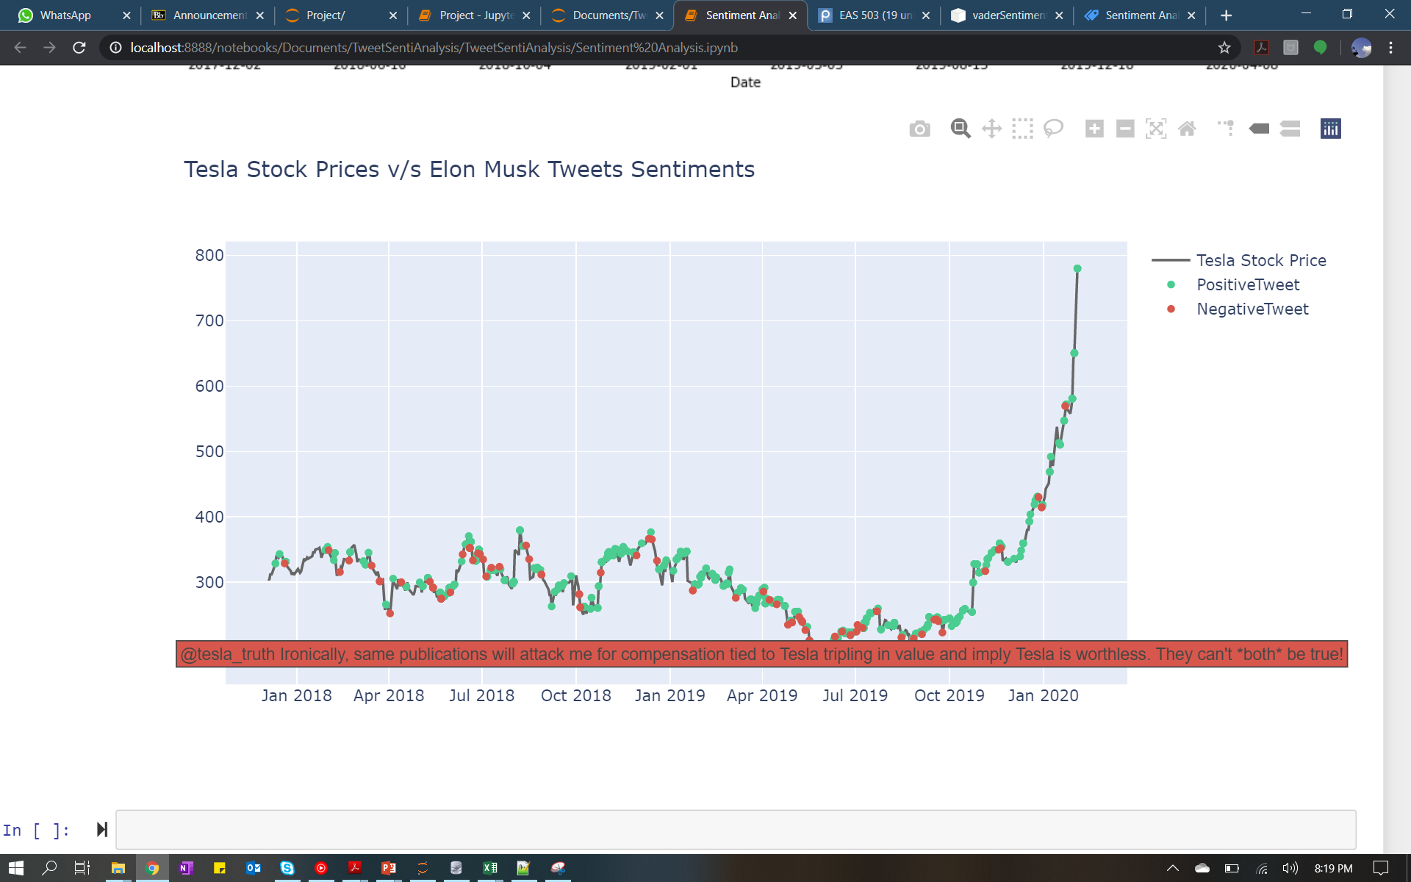
Plots and Inferences

Slide 8
Conclusion and Insights
The insights from the project are as follows:
From the plots, we are able to infer that the tweets from Elon Musk have a direct influence on the stock prices of Tesla
Whenever there is a positive tweet, we see a spike in the stock price and vice versa.
With further research, there is a possibility to precisely predict the fluctuations in stock prices based on the sentiment analysis scores.
Sentiment Analysis using VADER is not 100% accurate. However, there is a huge scope for research in this domain using concepts of Machine Learning.

Slide 9
Thank you

